Slide 1


Jessica Gunnell
7/2/24

Slide 2

Outline
Executive Summary
Introduction
Methodology
Results
Conclusion
Appendix

Slide 3
Executive Summary
Summary of methodologies
Data Collection
Data Wrangling
Exploratory Data Analysis
Interactive Visual Analytics
Predictive Analysis
Summary of all results
Exploratory Data Analysis result
Interactive analytics in screenshots
Predictive Analytics result

Slide 4
Introduction
Project background and context
SpaceX has had the most successful commercial space launches. They advertise the Falcon 9 rocket launches cost $62 million dollars; other providers cost upward of $165 million dollars. Much of the savings is because SpaceX can reuse the first stage. Therefore if we can determine if the first stage will land, we can determine the cost of a launch.
Problems you want to find answers
How do variable affect the success of the first stage landing?
Does the rate of successful in the first stage increase over the years?
Which methods provide the most accurate results to determine the success rate of a successful landing?

Slide 5

Section 1

Slide 6
Methodology
Executive Summary
Data collection methodology:
API request
Webscraping
Perform data wrangling
Transformed data to simple classifications to label launch success or not
Perform exploratory data analysis (EDA) using visualization and SQL
Perform interactive visual analytics using Folium and Plotly Dash
Perform predictive analysis using classification models
How to build, tune, evaluate classification models

Slide 7
Data Collection
Data collection for predicting the Falcon 9 first stage landing success was collected using both API requests and web scraping.
Historical data of SpaceX Falcon 9 launches was obtained from the SpaceX API
Multiple API endpoints were used to gather detailed information about each launch, including rocket details, payload information, launch site, and landing outcomes.
Helper functions were defined to make API requests and extract relevant data using identification numbers provided in the initial dataset.
The extracted data was stored in lists, which were then combined to create a comprehensive dataset.
Using BeautifulSoup additional launch records were extracted from Wikipedia
Column names were extracted from the table headers, and individual launch records were parsed and stored in a dictionary
The parsed data was converted into a Pandas Dataframe for further analysis and reprocessing

Slide 8
Data Collection – SpaceX API
Initialize Libraries: Import necessary libraries for HTTP requests, data manipulation, and date handling.
Define Helper Functions: Create functions to call SpaceX API and extract data for rocket, launchpad, payload, and cores.
Get Launch Data: Request and parse past SpaceX launch data using the SpaceX API.
Extract Detailed Data: Use IDs from the initial data to fetch detailed information on rockets, launchpads, payloads, and cores.
Store Data: Append the extracted data into lists
Github:API

Slide 9
Data Collection - Scraping
Fetch HTML Content ➡️ Extract Table Headers ➡️ Parse Launch Records ➡️ Create DataFrame
Fetch HTML Content: Use requests to get HTML page.
Extract Table Headers: Use BeautifulSoup to parse and extract column names.
Parse Launch Records: Loop through rows to extract data and store in a dictionary.
Create DataFrame: Convert dictionary to DataFrame.
Github: Webscrapping

Slide 10
Data Wrangling
The data wrangling process involves several steps to clean, filter, and extract relevant information from the SpaceX API, culminating in a well-structured DataFrame ready for analysis. This structured process ensures the data is accurate, complete, and standardized for predictive modeling tasks.
Clean Data:
Filter out row with multiple cores and payloads to ensure consistency
Convert columns with list-like values to single values
Handles missing values by replacing them with mean
Standardize Data:
Convert date-time values to appropriate formats
Create Final DataFrame:
add a Landing_class column where outcome is 0 or 1 to represent the outcome of each launch
Save Data:
Export processed data for analysis.
Github: Data Wrangling

Slide 11
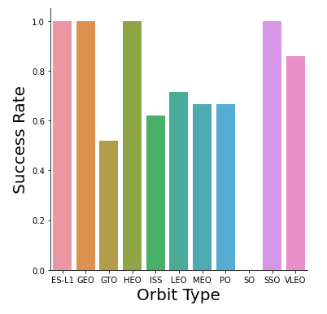
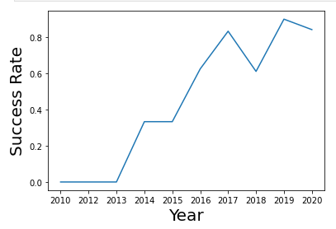
EDA with Data Visualization
Scatter plots:
Show a potential relationship between variables and aiding in risk assessment.
Charts plotted: Flight Number vs Payload Mass, Flight Number vs Launch Site, Payload Mass vs Launch Site, Flight Number v Orbit Type, Payload vs Orbit Type
Bar Charts:
To show the number of successful and unsuccessful launches for each year comparing orbit types
Charts plotted: Orbit Type vs Success Rate
Line Charts:
Observe a trend over time and evaluate the improvement or decline
Charts plotted: Success Rate Yearly Trend

Slide 12
EDA with SQL
List Unique Launch Sites : To retrieve and list all unique launch sites in the SpaceX dataset, which provides an overview of the different launch sites
Filter Launches by Specific Site : By filter launch sites that started with CCA we were able to analyze launches specific to Cape Canaveral
Sum of Payload Mass for NASA (CRS) : Able to get the total mass delivered for NASA missions
Average Payload Mass for a Specific Booster Version: Helped to understand the payload capacity for specific booster versions
Successful Missions : able to analysis only missions where the outcome was successful
Booster Versions with Successful Drone Ship Landings: identified effective booster versions for specific payloads
Booster Version with Maximum Payload: Highlights the capability of specific booster versions to handle heavy payloads.
Failed Drone Ship Landings in 2015:Helps in analyzing the frequency and distribution of failed landings throughout the year 2015.
Landing Outcome Count Between Specific Dates: Provides an overview of the most common landing outcomes during the specified period.
Github: EDA and SQL

Slide 13
Build an Interactive Map with Folium
Markers
Added markers to clearly identify and label the launch locations on the map. Also helped to identify the distances from highways, railroads, and cities provide information about proximity to key infrastructures.
Locations:
NASA Johnson Space Center
Each launch site
Closest highway, railroad, and city to each launch site.
Circles
Added circle objects to represent the radius around specific coordinates. Helped to understand the spatial extent and area of influence around the launch sites.
Locations:
NASA Johnson Space Center
Each launch site
Polylines
Polylines help to visualize the direct path between launch sites and geographical features
Connections:
From launch sites to nearest coastline/ highway/railroad/city
Github: Folium

Slide 14
Build a Dashboard with Plotly Dash
Launch Sites Dropdown Lists:
Added a dropdown list to enable Launch Site selection
Pie Chart showing Successful Launches:
Added a pie chart to show the total successful launch count for all sites and the Success v Fail count if a site was selected
Slider of Payload Mass Range:
Added a slider to select Payload range
Scatter Plot of Payload Mass v Success using callback function
Shows the correlation between payload and launch success

Slide 15
Predictive Analysis (Classification)
Creating a NumPy Array ➡️ Standardizing the Data ➡️ Splitting the Data ➡️ Creating GridSearchCVObject ➡️Applying GridSearchCV on Models ➡️Calculating Accuracy ➡️ Examining Confusion Matrix ➡️Finding the Best Method
Creating a NumPy Array: Creating a NumPy array from the column "Class" in data.
Standardizing the Data: Standardizing the data with StandardScaler, then fitting and transforming it.
Splitting the Data: Splitting the data into training and testing sets with train_test_split function.
Creating GridSearchCV Object: Creating a GridSearchCV object with cv = 10 to find the best parameters.
Applying GridSearchCV on Models: Applying GridSearchCV on LogReg, SVM, Decision Tree, and KNN models.
Calculating Accuracy: Calculating the accuracy on the test data using the method .score() for all models.
Examining Confusion Matrix: Examining the confusion matrix for all models.
Finding the Best Method: Finding the method that performs best by examining the Jaccard_score and F1_score metrics.
Github: Predictive Analysis

Slide 16
Results
Exploratory data analysis results
Interactive analytics demo in screenshots
Predictive analysis results

Slide 17

Section 2

Slide 18
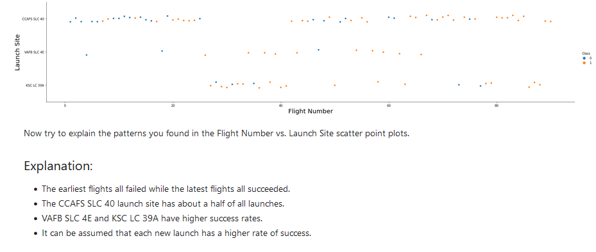
Flight Number vs. Launch Site

Slide 19
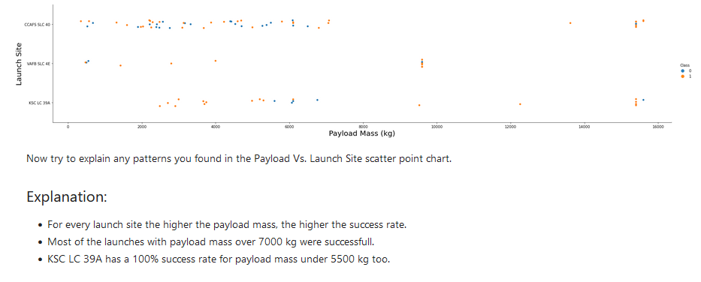
Payload vs. Launch Site

Slide 20
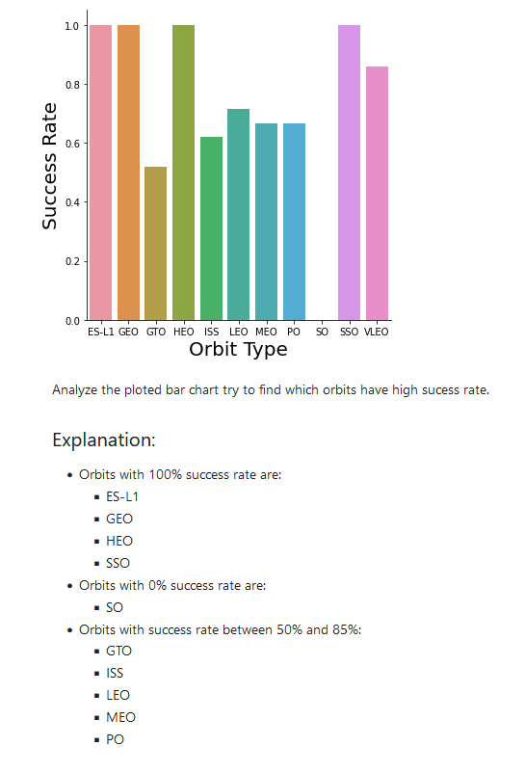
Success Rate vs. Orbit Type

Slide 21
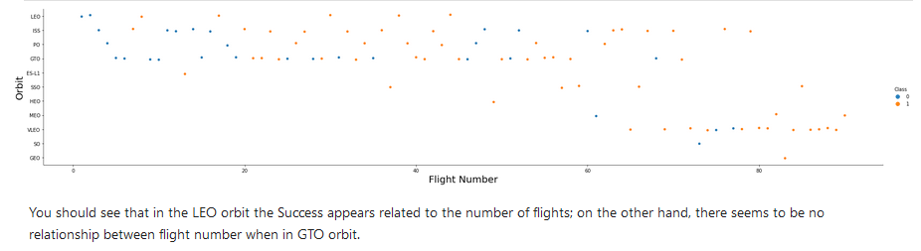
Flight Number vs. Orbit Type

Slide 22
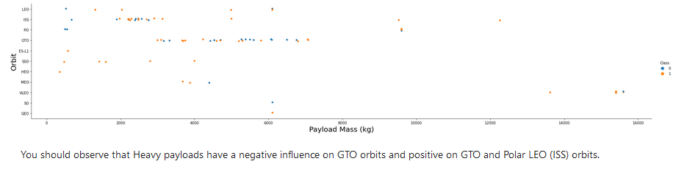
Payload vs. Orbit Type

Slide 23
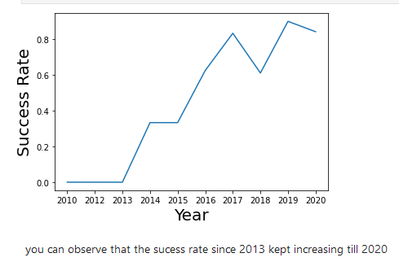
Launch Success Yearly Trend

Slide 24
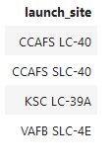
All Launch Site Names
%sql SELECT DISTINCT(LAUNCH_SITE) FROM SPACEXTBL;
Displays the names of the unique launch sites

Slide 25
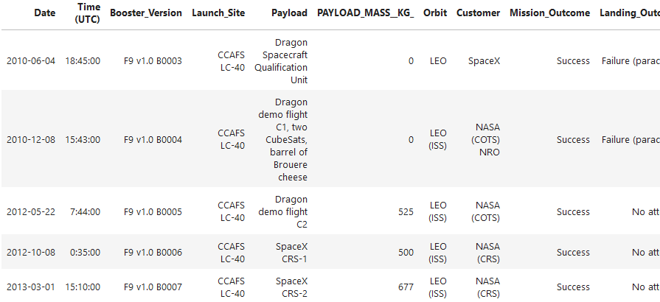
Launch Site Names Begin with 'CCA'
%sql SELECT * FROM SPACEXTBL WHERE LAUNCH_SITE LIKE'CCA%' LIMIT 5;
To filter and retrieve details of launches that occurred at launch sites starting with "CCA".

Slide 26
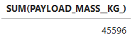
Total Payload Mass
%sql SELECT SUM(PAYLOAD_MASS__KG_) FROM SPACEXTBL WHERE Customer = "NASA (CRS)";
To calculate the total payload mass for missions where the customer was NASA (Commercial Resupply Services).

Slide 27
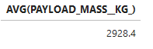
Average Payload Mass by F9 v1.1
%sql SELECT AVG(PAYLOAD_MASS__KG_) FROM SPACEXTBL WHERE Booster_Version = "F9 v1.1";
To calculate the average payload mass for launches using the "F9 v1.1" booster version.

Slide 28
First Successful Ground Landing Date
%sql SELECT * FROM SPACEXTBL WHERE Mission_Outcome = "Success";
To retrieve all records of successful missions.

Slide 29
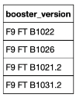
Successful Drone Ship Landing with Payload between 4000 and 6000
%sql SELECT Booster_Version FROM SPACEXTBL WHERE Landing_Outcome='Success (drone ship)' AND PAYLOAD_MASS__KG_ > 4000 AND PAYLOAD_MASS__KG_ < 6000;
To find booster versions that successfully landed on a drone ship with payload masses between 4000 kg and 6000 kg.

Slide 30
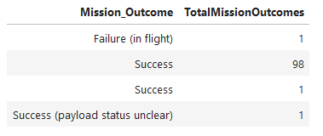
Total Number of Successful and Failure Mission Outcomes
%sql select Mission_Outcome, count(MISSION_OUTCOME) as TotalMissionOutcomes from SPACEXTBL GROUP BY MISSION_OUTCOME
To retrieve all records of successful missions.

Slide 31
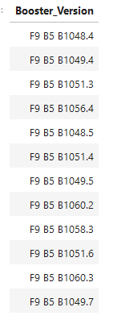
Boosters Carried Maximum Payload
%sql SELECT Booster_Version FROM SPACEXTBL WHERE PAYLOAD_MASS__KG_ = (SELECT MAX(PAYLOAD_MASS__KG_) FROM SPACEXTBL);
To find the booster version used for the launch with the maximum payload mass.

Slide 32
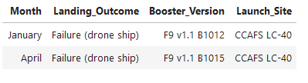
2015 Launch Records
%sql SELECT CASE WHEN SUBSTR(Date, 6, 2) = '01' THEN 'January' WHEN SUBSTR(Date, 6, 2) = '02' THEN 'February' WHEN SUBSTR(Date, 6, 2) = '03' THE
To retrieve records of failed drone ship landings in 2015, categorized by month.

Slide 33
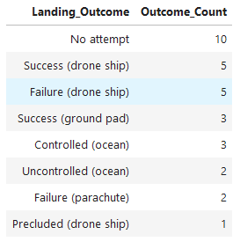
Rank Landing Outcomes Between 2010-06-04 and 2017-03-20
%sql SELECT Landing_Outcome, COUNT(*) AS Outcome_Count FROM SPACEXTBL WHERE Date BETWEEN '2010-06-04' AND '2017-03-20' GROUP BY Landin
To count the occurrences of each landing outcome between specific dates.

Slide 34

Section 3

Slide 35
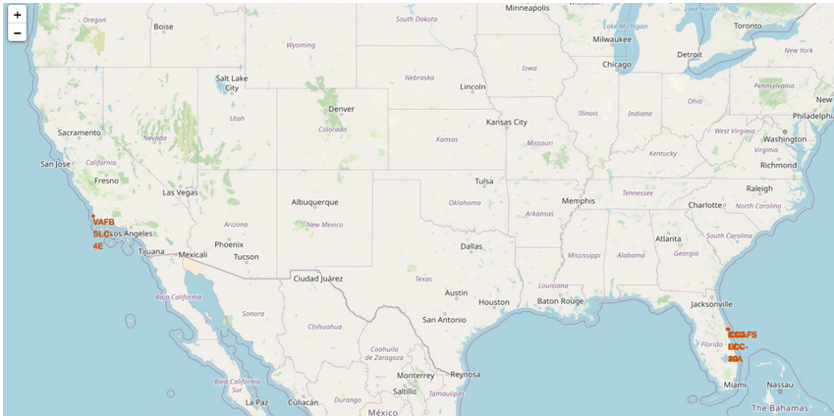
Launch sites location markers
All launch sites are in very close proximity:
to the coast: while launching rockets toward the ocean to minimize the risk of debris over populated areas
Rails: in order to easily procure goods

Slide 36
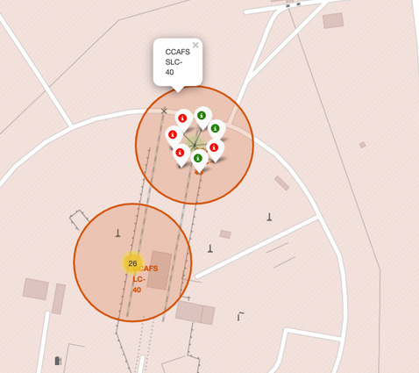
Launch Records
Each launch site is marked with a green or red marker to should success rates:
Green = successful launch
Red = Failed Launch

Slide 37
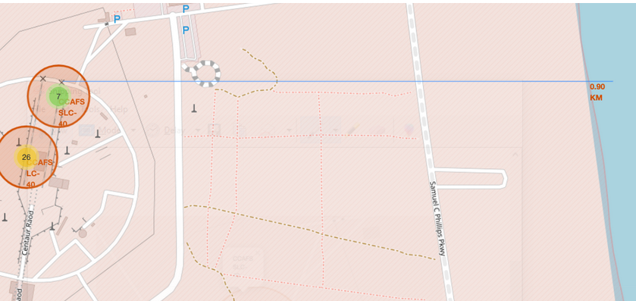
Distance from to geographical area
Each Launch site calculates how close a railway, highway and coastline are

Slide 38

Section 4

Slide 39
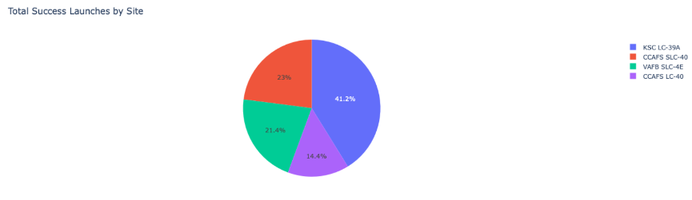
Launch success count for all sites
Explanation:
The chart shows that KSC LC-39A has had the most successful launches representing 41.2% of the successful launches

Slide 40
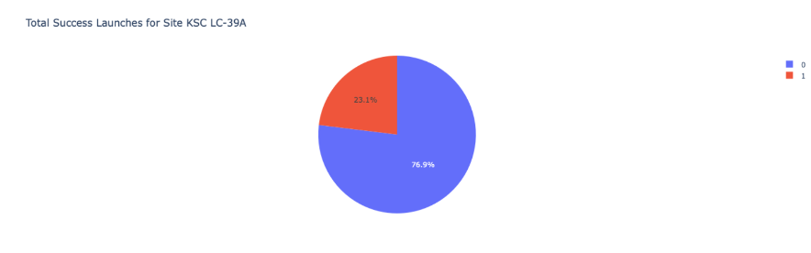
Launch site by highest launch success ratio
Explanation:
Launch site KSC LC-39A has a 77% success rate

Slide 41
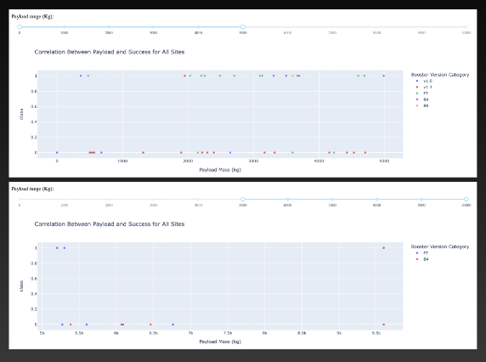
Payload vs. Launch Outcome
Explanation:
The chart shows that payloads between
2000 and 5500 kg have the highest
Success rate.

Slide 42

Section 5

Slide 43
Classification Accuracy
Visualize the built model accuracy for all built classification models, in a bar chart
Find which model has the highest classification accuracy

Slide 44
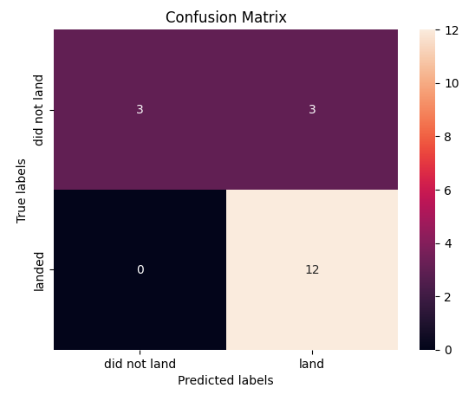
Confusion Matrix
The best performing confusion matrix has an accuracy of 83.3%. Which demonstrates good performance when predicting the landing success of the Falcon 9 first stage.

Slide 45
Conclusions
The Decision Tree Model is the best algorithm for this dataset
KSC LC-39A has the highest rate of success rate of all launch sites
Orbits of ES-L1, GEO, Heo and SSO have 100% success rates
The success rate has improved over time
Launches with low payload mass shoe better results

Slide 46
Appendix
Include any relevant assets like Python code snippets, SQL queries, charts, Notebook outputs, or data sets that you may have created during this project

Slide 47


